Slide 1


Introduction to business and management (Jaguar Land Rover Ltd.)

Slide 2

Introduction
Jaguar Land Rover is a Luxury automobile brand that is based in the UK. It is headquartered at Whitley, Coventry, UK (jaguarlandrover.com, 2023).
Jaguar Land Rover was founded in 1922 as the Swallow Sidecar Company 1922.
William Lyons and William Walmsley founded this company
The organization has made a loss of 861 Million GBP in the year 2021.
The company has sold around 1,00,000 cars worldwide and 22529 cars in the UK itself in 2021.
The company also manufactures sports utility cars along with luxury cars (Hasenkopf and Steiner 2021).
Notes:
The Jaguar Land Rover is a British multinational company that was established in 1922 by William Lyons and William Walmsley. The company aims to bring revolution in the luxury cars segment in the country. The company aims at manufacturing high-performance Luxury cars with the integration of modern high-end technology. The company is a subsidiary of Tata Motors since 2008. Natarajan Chandrasekaran is the chairman of the company and Adrian Mardell is the CEO of the company. Along with the production unit the company also has research and development facilities in the UK. The brand aims at electrification of all its vehicles by 2025. The company has also partnered with different universities such as the University of Warwick for the development of innovative products.

Slide 3


Structure of the presentation
In this presentation, the analysis of internal and external macro environments of the company of Jaguar Land Rover will be done.
An in-depth analysis of the strengths and weaknesses of the capabilities of the company in the UK will be done as per the environmental analysis of the company.
The organizational structure and challenges faced by the company in the current times will also be discussed in this presentation.
A possible solution and recommendation will also be provided in this report.
Notes:
The company structure and external environment of the company of Jaguar Land Rover in the UK will be studied in this report. The challenges and the solution to the challenges faced by the company in the UK will also be done in this report.

Slide 4
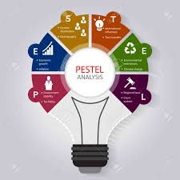

PESTLE analysis of the business
POLITICAL -Political stability is the biggest strength of the company in the country of UK which offers a stable environment for the company to carry out its operations seamlessly in the country of the UK.
POLITICAL -Brexit hurts the operations of the company as it has increased the tariff for the imports it will make for its production unit in the UK (Li et al., 2019). Brexit has resulted in labour shortage issues and disrupted the supply chain of the company in the UK.
ECONOMICAL - The per capita income of the UK is 49420 PPP USD in the year 2021 which means the people of the UK have a good disposable income to buy the vehicles manufactured by the company.
ECONOMICAL - The GDP of the UK grew by 4.1 % in 2022 against 7.5% in 2021 and it is expected to grow which will be a positive factor for the company.
Notes:
The country of the UK has a stable democratic government which is a positive factor for the company to grow in the Uk, on the other hand, Brexit has had some negative impact on the company where the company has experienced increased tariffs for imports and labour shortage issues. The people in the UK have a good disposable income with a good GDP growth rate of 4.1% in 2022 which is favourable for the country.

Slide 5


Continued..
SOCIAL - The mortality rate of the Uk is 10 deaths per 1000 people which is better than most of the other countries.
SOCIAL - The population growth rate of the country is 0.37% in 2021. The societal trends and norms of the country are also favourable as the people are aware and educated.
TECHNOLOGICAL - UK has technology penetration of high-end technologies in the automobile industry which will be favourable for the innovation company (Santos and Davies 2020). The company is also using new cutting-edge technology in its vehicles to bring a revolution in the luxury car segment.
TECHNOLOGICAL - The biggest technology environment challenges the company is facing is the Electrification of vehicles and awareness of the people about the benefits of Electric vehicles. The company is also working hard to manage the technological trend by transforming its vehicles to Electric vehicles by 2025.
Notes:
The country of the UK has a favourable social condition as the mortality rate of the country is low and the population of the country is also growing which will be favourable for the company. The country of the UK has a good penetration of technology which will be used by the company. The increased awareness of Electric vehicles in the Uk will be a challenge for the company.

Slide 6
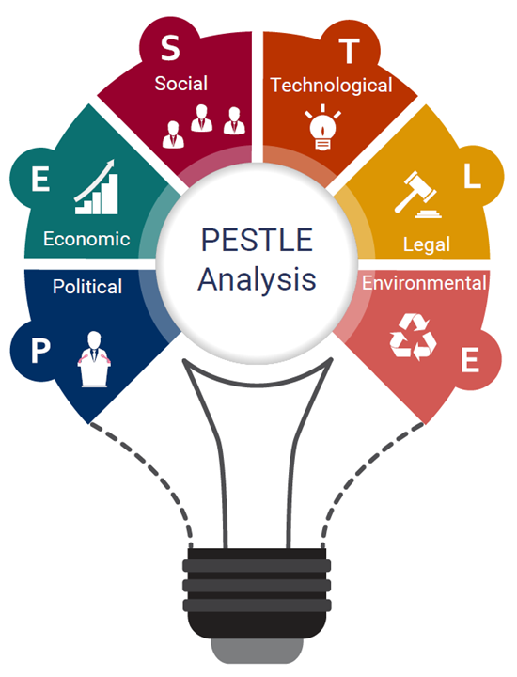
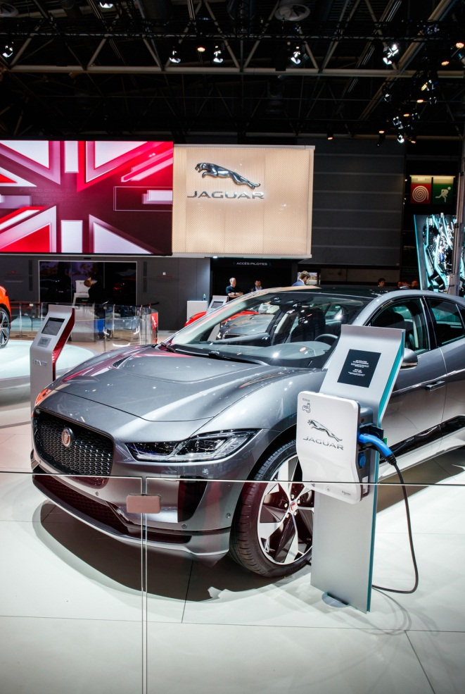
Continued..
LEGAL - The company has to abide by the employment rights act 1996 of the UK to provide fair and proper working conditions and practices for the employees. The company has to abide by the Human rights act of 1998 to protect the human rights of the employee at the workplace and the Human rights of the customers.
LEGAL - The company has to abide by the Consumer protection act 2007 and the consumer protection act 2014 to protect the rights of the customers buying their products.
ENVIRONMENTAL - The company has to abide by the environment protection act 1990 to manage its operations in such a way that it does not contribute towards pollution of any kind.
ENVIRONMENTAL - The people of the UK are aware of the environmental issues consequently the company should try not to contribute to the carbon footprint.
Notes:
The company has to abide by the employment rights act 1996 of the UK and the Human rights act 1998 to protect the interests of its employees and customers. The company has to abide by all consumer protection regulations to provide fair services to its customers. The organization has to abide by the environmental regulations and the environmental awareness of the country which will help the company to achieve sustainable growth in the UK.

Slide 7

PESTLE analysis influence and its positive impact
The country of UK is a developed country with good disposable income of the people which will be helpful for the company to achieve sustainable growth in the country.
The country of the UK is favourable for the technological innovation for the vehicles of Jaguar Land Rover as the country has a good penetration of the technology.
The company follows good human resource practices which will help the company to abide by the Employment Act and human rights protection act of the country.
The environmental awareness of the country of the UK is also favourable for the company of Jaguar Land Rover as the company is also aware of its responsibilities towards the environment.
Notes:
The country of the Uk has a stable government with good economic conditions of the people with a good disposable income in the hands of the people of the UK. This is good for the company as the company deals with luxury and sports cars which are manufactured for high-income customers. In terms of environmental regulations, the company has good awareness of its business activities' effect on the environment and is taking corrective measures to address the issues which will be helpful for the company to grow in the UK. JLR has made investments in the infrastructure for the increased use of renewable energy and the electrification of its vehicles.

Slide 8


PESTLE analysis and its negative impact
The biggest negative impact of the political environment is Brexit which has made a serious impact on the organization. Brexit has disrupted the supply chain of the company in the country as most of the parts and technology of the vehicles are imported from different other countries (Bailey, 2019).
Brexit also has caused labour shortage issues in the company due to the immigration and Visa related complications associated with Brexit (Farid, 2021).
The people of the UK are environmentally aware which influenced their choices to buy a particular product also, this means the company has to shift to the Electrification of its vehicles fully which will help the company to catch the attention of the people of the UK.
The company is also facing challenges in terms of technology as the competitors are integrating the technology faster than the company which is a big challenge for the company in the UK. This has delayed the electrification drive of the company.
Notes:
Brexit hurts the business of Jaguar Land Rover by disrupting its supply chain and workforce supply (Bailey et al., 2022). The company is also facing challenges to integrate technology in the fast-paced technological environment in the UK.

Slide 9

Strengths analysis of the business
The biggest strength of Jaguar Land Rover is the brand value of the company. The company has a good brand perception and Goodwill in the UK luxury car market (Focacci and Kirov 2021).
The company has maintained a good business performance due to good Human resource management of the company. The Human resource of the company is the strength of the company which has helped the company to achieve sustainable growth.
The company has created a market category in the customer's perceptions which cannot be achieved by any other brand. The company has a skilled workforce that has helped the company to become a famous luxury car and sports car brand in the UK.
The company delivers quality products that are backed by a strong research and development infrastructure of the company.
Notes:
The brand value and the goodwill that the company has achieved are its biggest strengths. The brand has created a market segmentation of luxury cars that cannot be easily achieved by other companies. The skilled workforce of the company is the biggest strength of the company which has helped the company to achieve sustainable business growth. The company also delivers high product quality that is backed by high investment in research and development of the company in the UK.

Slide 10


Weakness analysis of the business
The slow electrification of the vehicles manufactured by the company is its biggest weakness which will give its competitors benefits over itself.
The company has less product range which does not provide the customers with ample range to choose from which is also a weakness of the brand. Due to less product range, the company has to depend on a few of its vehicle models to drive its business in the UK luxury and sports car market.
The company has started cost-cutting in its various departments to address the implications of Brexit and Covid-19 which has led to trade union issues within the company.
The company is losing the technology war in comparison to its German and Japanese luxury brands.
Notes:
The company enjoys a good brand perception and brand value in the UK market. However, there are some weaknesses of the company which are affecting its business. The company is slow in the electrification of its vehicles which is making it a less sought-after brand in terms of electric vehicles in the UK market. The brand is also facing cost-cutting issues due to covid 19 and Brexit which has resulted in staff dissatisfaction. The company is also faring behind German and Japanese luxury cars in terms of new technology.

Slide 11


Connection of strengths and weakness analysis relating to PESTLE
Due to proper legal regulations of the government in the UK, the company has maintained a good Human resource policy which has helped the company to achieve success in the long run.
Due to the High disposable income of the people of the UK and favourable economic conditions in the country, the company has achieved economies of scale in the luxury car segment in the UK market.
Brexit has a negative implication on the business of Jaguar Land Rover as the company faced issues related to the skilled and semiskilled labour shortage due to Brexit. Brexit has also disrupted the supply chain of the organization as different parts of the vehicles are imported from different part of the world to be integrated in UK for e.g. - Singapore and India.
The company due to Brexit-related issues and covid -19 has faced severe disruption in the electrification of its vehicles which has left the brand behind its German and Japanese counterparts.
Notes:
Due to the strict regulations of the UK, the company has developed a fair human resource practice in the organization. The high disposable income of the people of the UK has also helped the country to gain a market share between 2 to 3 percent of cars sold in the UK. However, the company has faced issues of labour shortage and increased tariff-related issues due to Brexit.

Slide 12


Organizational structure of the selected business
The company follows a narrow-span organizational structure in which a large number of the subordinates report to single high-level management.
The highest level of management of the company consists of the chairman and the CEO. Below them are the corporate head and the vice president for administration.
The next level of the organizational structure consists of the general manager and the unit head administrators. This level is followed by the HRM, production and sales heads and the last of the hierarchy is the staff.
Notes:
The company follows a narrow span of organizational structure where one manager is responsible for a large number of reportees.

Slide 13
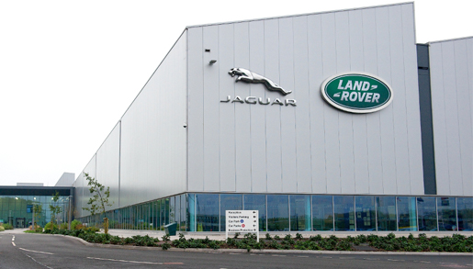

Current challenge of the organization
The biggest challenge the company faced is the electrification of its vehicles and making them emission-free as soon as possible (Dia 2019). The company is facing competition from Volkswagen due to its huge capacity to produce batteries for EVs in the UK market.
The company has fallen behind its competitors who have proactively addressed the issue to get a market advantage over Jaguar Land Rover.
The issues related to supply chain disruptions, tariffs issues and the lockdowns associated with the Covid 19 made the company face issues in vehicle electrification.
Local governments such as the Westminster government have banned combustible engine vehicles which will be a big concern for the company which is still working to convert the entire vehicles into the electric variant (Eckersley et al., 2022).
Notes:
The biggest challenge the company is facing is replacing its diesel and petrol vehicles with EVs as soon as possible. The company is facing challenges from competitors such as Volkswagen which has a good capacity to produce batteries that can be used in Electrical vehicles. Along with the awareness of the people about Emission-free vehicles, some of the local Governments in the Uk are also banning combustible engine vehicles which is a big challenge for the company of JLR.

Slide 14

Recommendation of Solution to the Challenge
The company can address the issue by making high investments in the infrastructure so that the combustible engines can be replaced by Electric engines.
The company can also take the help of its competitor to address the issue with the help of the well-established infrastructure of its competitors.
The company can also invest in research and development to develop highly innovative engines that will be highly efficient and energy efficient.
Notes:
The company can make more investments to speed up the process of electrification of the vehicles, the company can also take the help of its competitors to share the infrastructure so that the process of electrification can be boosted. The company can also invest in research and development to find new ways to increase the efficiency of the fuel engines and cut the emission from the use of the fuels in its vehicles.

Slide 15

Continued..
The organization can set a highly achievable target for itself in place of the unrealistic target that will further worsen the situation of the organization.
The JLR can also take the help of the government of the UK to fast-track its process of electrification.
The company can also identify new technologies that can be used in the transition of the company from fuel-based vehicles to EVs.
Notes:
The organization has to set achievable targets for itself which will help the company to achieve the target confidently. JLR can also take the help of the UK government to speed up its process for electrification as the UK Government is also working towards an emission-free economy (Bonsu 2020). The company can identify the use of new technologies that can be used in its electrification drive.

Slide 16

Conclusion
In this presentation, the organization and organizational structure of Jaguar Land Rover were studied extensively.
The report found that the macro-environment of the UK is catalyzing the company to grow.
The company has also faced issues from the macro environment of the UK in the form of Brexit.
The company is facing issues of slow electrification of its vehicles which has affected its business in the UK. Recommendations are made in this report for the organization to counter the challenge faced by JLR.
Notes:
The report has studied the organization of JLR and its challenges in this report. The report found that the macro environment has favoured the company to grow in the UK. Jaguar Land Rover is lagging behind its competitors in terms of the electrification of its vehicles in the UK market. Recommendations are made in this report so that the challenge can be addressed in future.

Slide 17

References
Bailey, D., 2019. Auto makers prepare to shut down again fearing No Deal Brexit disruption.
Bailey, D., De Ruyter, A., Hearne, D. and Ortega-Argilés, R., 2022. Shocks, resilience and regional industry policy: Brexit and the automotive sector in two Midlands regions. Regional Studies, pp.1-15.
Bonsu, N.O., 2020. Towards a circular and low-carbon economy: Insights from the transitioning to electric vehicles and net zero economy. Journal of Cleaner Production, 256, p.120659.
Dia, H., 2019. Rethinking urban mobility: unlocking the benefits of vehicle electrification. Decarbonising the Built Environment: Charting the Transition, pp.83-98.
Eckersley, P., Harrison, O. and Poberezhskaya, M., 2022. A new framework to understand the drivers of policy mixes in multilevel contexts: The case of urban air pollution. Environmental Policy and Governance.
Farid, M., 2021. The Winners and Losers of Brexit: A UK Manufacturing Sector Analysis. Available at SSRN 3765122.
Focacci, C.N. and Kirov, V., 2021. Regional entrepreneurial ecosystems: Technological transformation, digitalisation and the longer term—The automotive and ICT sectors in the UK and Bulgaria. Local Economy, 36(1), pp.56-74.
Hasenkopf, B.C. and Steiner II, R.F., 2021. Masculinity, Car Culture, and Carbon Emissions.
jaguarlandrover.com, 2023 Available at https://www.jaguarlandrover.com/

Slide 18
References
Li, D., Shishank, S., de Ruyter, A., Ali, S., Bailey, D., Hearne, D. and Salh, S., 2019. Brexit and the auto industry: Understanding the issues for supply chain management. In Brexit negotiations after article 50: Assessing process, progress and impact (pp. 173-191). Emerald Publishing Limited.
Nath, K. and Dwivedi, R., 2021. Aesthetic Exploration of Organizational Theatrics: a Case of Tata Motors’ Jaguar Land Rover Acquisition. Philosophy of Management, 20(3), pp.369-386.
Ramkumar, S., 2020. Influence of inter-firm network relationships on circular economy eco-innovation adoption. Sustainability, 12(18), p.7607.
Santos, G. and Davies, H., 2020. Incentives for quick penetration of electric vehicles in five European countries: Perceptions from experts and stakeholders. Transportation Research Part A: Policy and Practice, 137, pp.326-342.
Statista.com, 2023 Available at https://www.statista.com/

Slide 19
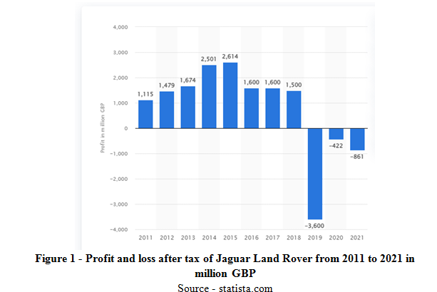
Appendix

Slide 20
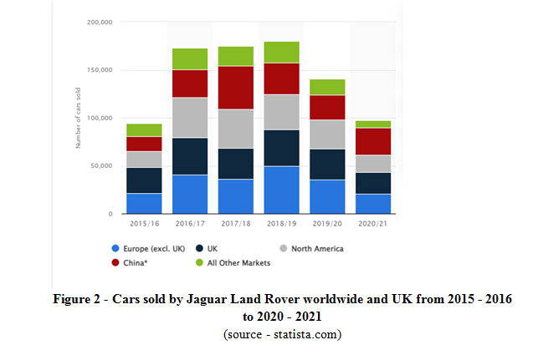

Slide 21
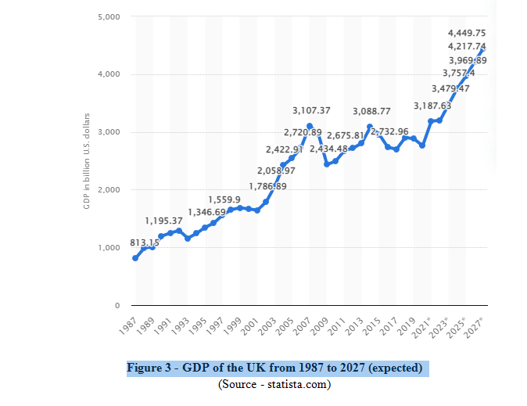

Slide 22
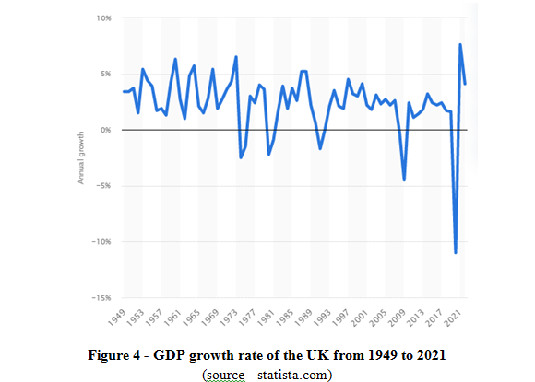

Slide 23
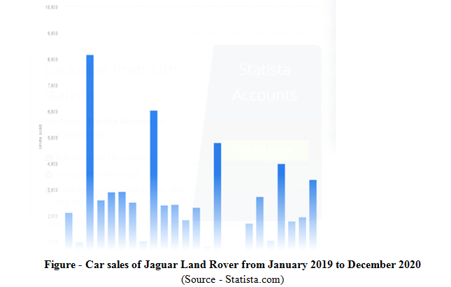

Slide 24
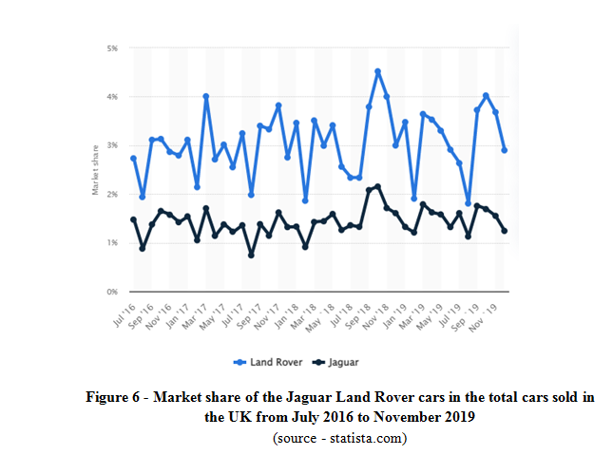

Slide 25


